Slide 1
Lambda function
-- Danni Long

Slide 2

Lambda function : It is just another way to define a function
Aka: anonymous function
def add2(x):
return x+2
x->x+2
lambda x: x+2

Slide 3
Lambda function
Assigning it to a varible(Not recommended )
add2 = lambda x: x+2
print( add2(2) )
4
Without assigning it to a varible:
(lambda x: x+2)(2)
→ 4

Slide 4
Lambda function
When do we use lambda function?
written in a single-line
used once

Slide 5
Lambda function
Sytax:
Accept zero or more arguments, but only one expression
lambda x: expression
lambda x1,x2,x3: expression
lambda : expression

Slide 6
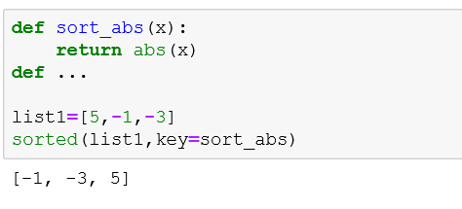

Lambda function
Common useage:
In python: with built-in functions
sorted(sequence, key=function)

Slide 7
Lambda function
Common useage:
In python:
map(sequnce, function) : function working on each item in the sequence
(lambda x: x+2)(2)
->4
(lambda x: x+2)([1,2,3]) → [1,2,3] + 2 ?
->[3,4,5]?

Slide 8
Lambda function
Common useage:
In python3:
(lambda x: x+2)([1,2,3])
map([1,2,3], lambda x:x+2)

Slide 9
Lambda function
Common useage:
In python3:
(lambda x: x+2)([1,2,3])
list (map([1,2,3], lambda x:x+2))

Slide 10
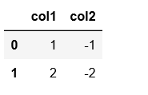
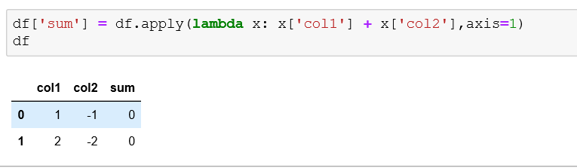
Lambda function: Common usage in Pandas
Sytax:
df[‘new_column’] = df.apply(lambda x: expression, axis=1)
Example1 :

Slide 11
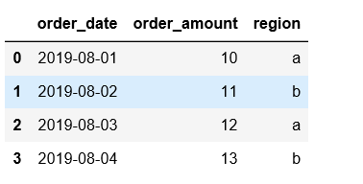
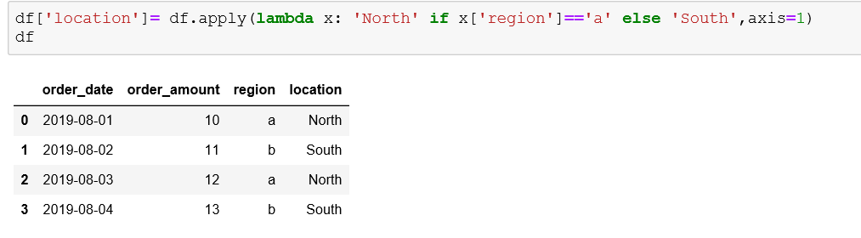
Lambda function: Common usage in Pandas
Example2 :
2.1 add a new column named ‘location’ into the dataframe: if region is ‘a’ then ‘location’ is ‘South’, everything else will be ‘North’

Slide 12
Lambda function: Explicit is better than implicit
Guess:
lambda x: [[y for j, y in enumerate(set(x)) if i>j] for i in range(2**len(set(x)))]
-> expected output?

Slide 13
Thank You

Slide 14
